Slide 1
“It Shall Stand Forever”
Daniel 2:44

Slide 2
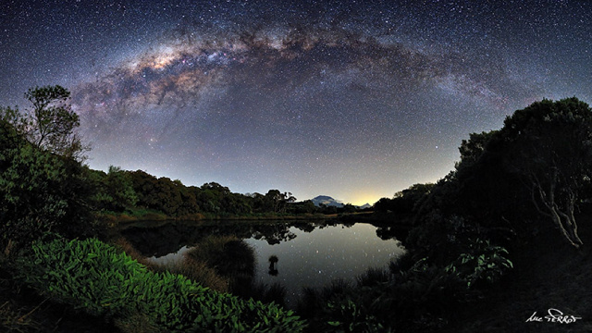
What will we learn?
What is the meaning of life?

Slide 3
What will we learn?
We will also answer:
  What will happen in the future to Planet Earth?
  What will happen to humanity?
Information Source: the Bible

Slide 4
Daniel 2:44
Daniel 2:44
  And in the days of these kings shall the God of heaven set up a kingdom, which shall never be destroyed: and the kingdom shall not be left to other people, but it shall break in pieces and consume all these kingdoms, and it shall stand for ever.
What is “it”?
How long is “for ever”?
Who or what are “all these kingdoms”?
Kingdom set up by the God of heaven
Chal. word Awlam or Olam: remote time
“these” tells us that we need to look back into the chapter.

Slide 5
Daniel 2
Daniel 2 tells us of a vivid dream had by Nebuchadnezzar
He was troubled deeply and it awoke him out of sleep
He wanted to know the meaning and asked his magicians, astrologers, sorcerers and the Chaldeans to know the dream and its meaning
Nebuchadnezzar could not remember the dream
Of course they could not interpret a dream they didn’t know – but Nebuchadnezzar told them they must interpret it or die
Nebuchadnezzar ordered all the wise men of Babylon to be destroyed

Slide 6
Daniel 2
When the prophet Daniel heard of this he inquired to Nebuchadnezzar through Arioch, the King’s captain
Daniel then requested time to meet with Nebuchadnezzar to make known his dream and the interpretation
The God of heaven revealed the dream to Daniel in a night vision
Daniel then went before Nebuchadnezzar to tell him the dream and the interpretation by explaining that the God of heaven revealed it to him

Slide 7
Daniel 2
The dream was a great image with:
Head of gold
Breast and arms of silver
Belly and thighs of brass
Legs of iron
Feet of part clay and part iron
Then came a stone cut out without hands which hit and destroyed the image upon his feet and brake it to pieces and turned it to chaff and the stone became a great mountain filling the whole earth

Slide 8
Daniel 2
Daniel then tells Nebuchadnezzar the meaning:
  The head of gold is the kingdom of Babylon
  The silver, brass, iron and part clay/part iron are kingdoms after Babylon, with the part clay and part iron being a divided kingdom and it makes special mention of the toes
  The stone which destroyed the image is the kingdom of God which will replace these kingdoms of men and be a mountain which will fill the whole earth
Google search we find a relatively consistent message on labelling these kingdoms

Slide 9
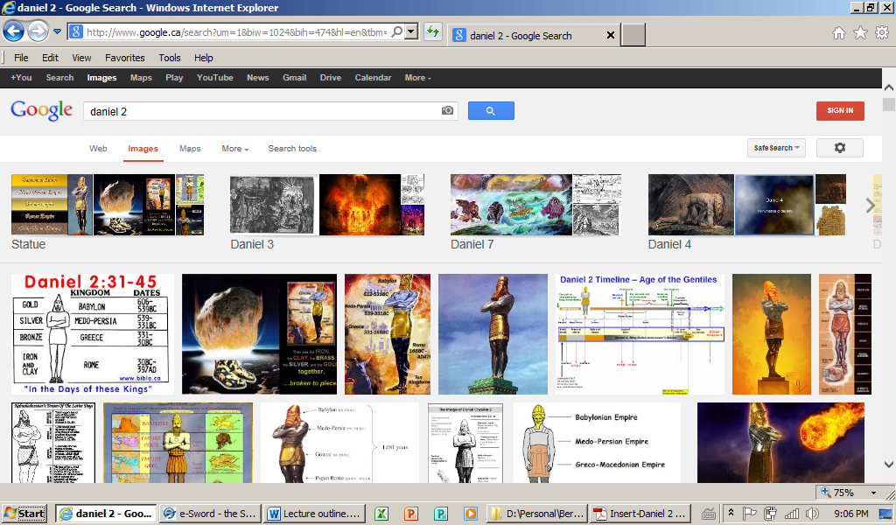
Google

Slide 10
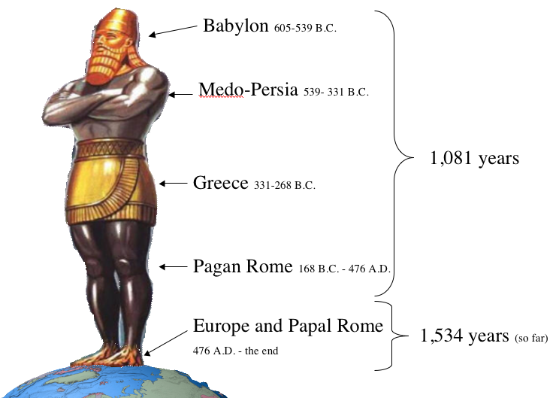
Google

Slide 11
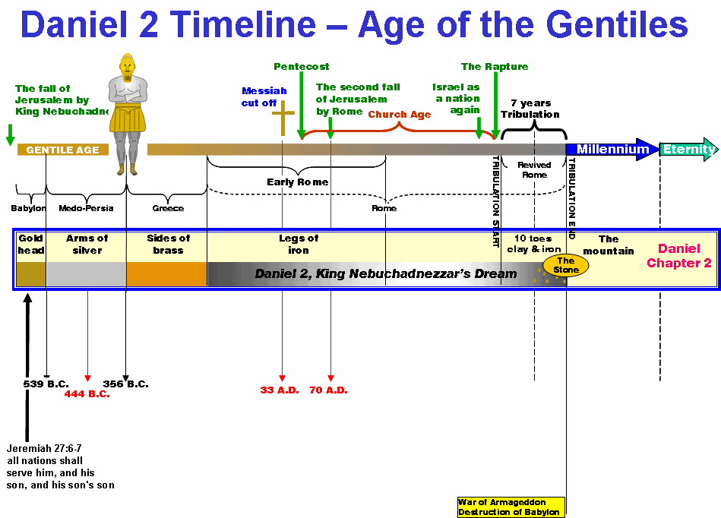
Google

Slide 12
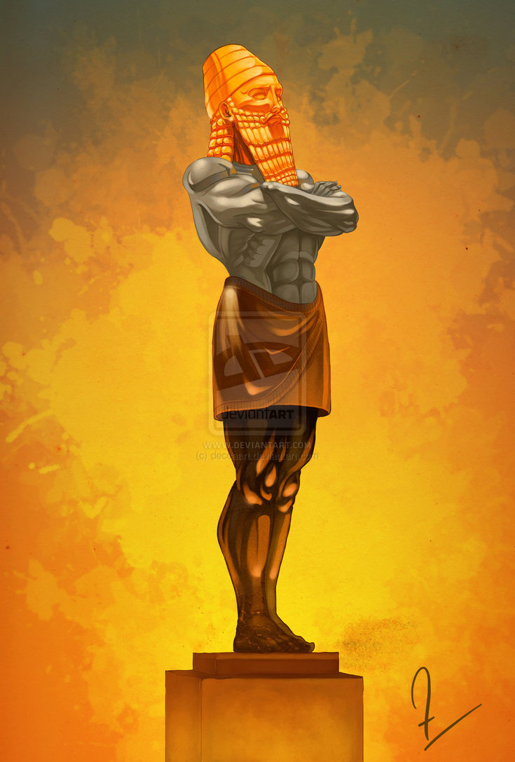
Google

Slide 13
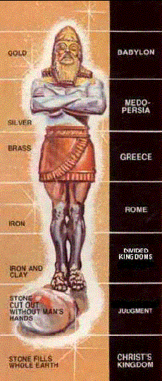
Google

Slide 14
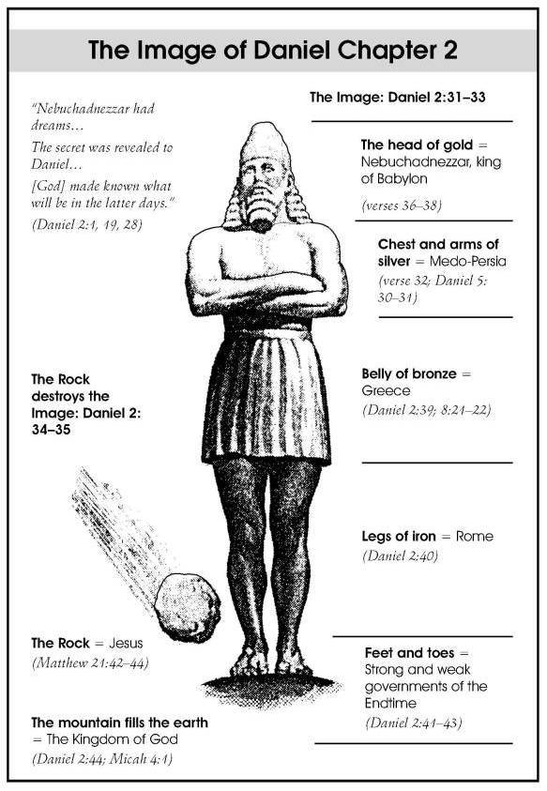
Google

Slide 15
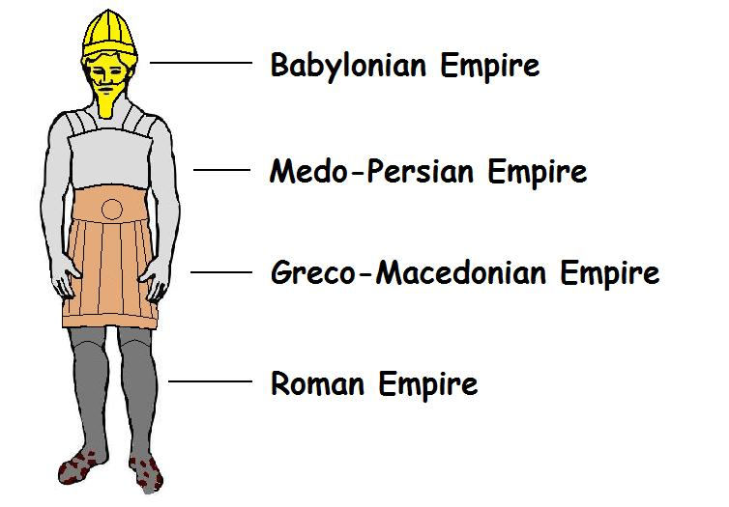
Google

Slide 16
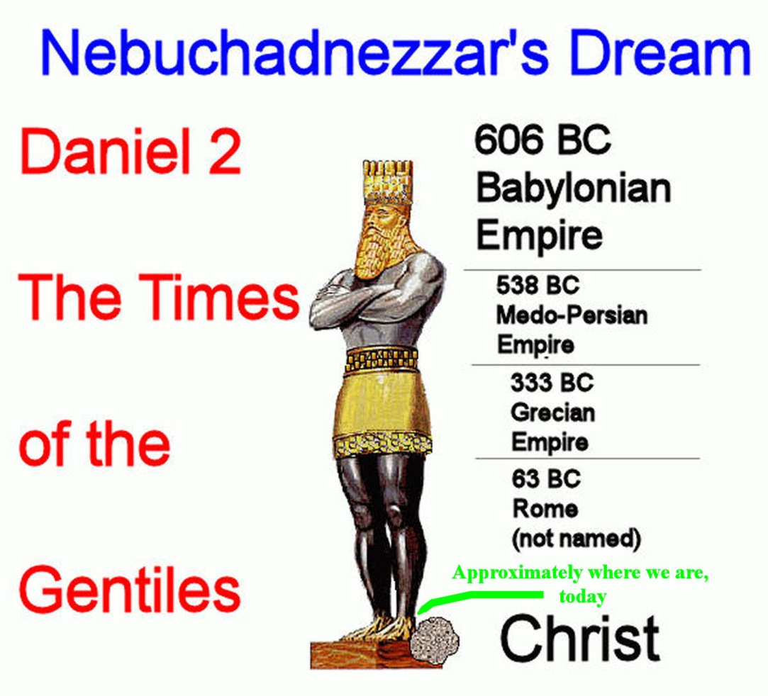
Google

Slide 17
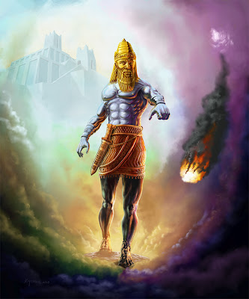
Google

Slide 18
Biblical Teaching
Handout
A divine political Kingdom will be established on Earth
All governments of man will be destroyed in order to bring the world into subjection to God
This Kingdom will be the restored ancient Kingdom of Israel
Jerusalem will be the capital
The Jews will be gathered from their present dispersion among the nations
Jesus will be the supreme ruler
The saints will inherit the Kingdom under Christ

Slide 19
Biblical Teaching
As we go through the biblical teachings we will see that the prophecy of Nebuchadnezzar’s image (Daniel 2) is in total alignment with the remainder of scriptures
Daniel 2:45
  the great God hath made known to the king what shall come to pass hereafter: and the dream is certain, and the interpretation thereof sure.
  Let’s go into the scriptures…

Slide 20
Future Kingdom on Earth
Matthew 5:3
  Blessed are the poor in spirit: for theirs is the kingdom of heaven.
Matthew 5:5
  Blessed are the meek: for they shall inherit the earth.
Heaven or Earth?
Lord’s Prayer – Matthew 6:9-10
  Our Father which art in heaven, Hallowed be thy name. Thy kingdom come. Thy will be done in earth, as it is in heaven.
The Bible is full of instruction of repentance: the law of Moses, the Prophets, John the Baptist, the ministry of Jesus

Slide 21
Future Kingdom on Earth
God wants to collect a “godly seed” (Malachi 2:15)
That is the purpose of humanity – God wants a godly seed
Numbers 14:21
  But as truly as I (God) live, all the earth shall be filled with the glory of the LORD.
“I will be your God, and ye shall be my people”
  Jeremiah 7:23, 11:4, 30:22, 31:1,33, 32:38
  Ezekiel 11:20, 14:11, 36:28, 37:23,27
  Zechariah 8:8
  Hebrews 8:10
  Revelation 3:21

Slide 22
Future Kingdom on Earth
Abraham was promised a seed and a possession – Genesis 13:14-15
  And the LORD said unto Abram…Lift up now thine eyes, and look from the place where thou art northward, and southward, and eastward, and westward: for all the land which thou seest, to thee will I give it and to thy seed for ever.
Hebrews 11:8-9, 13, 39
  By faith Abraham, when he was called to go out into a place which he should after receive for an inheritance, obeyed; and when he went out, not knowing whither he went. By faith he sojourned in the land of promise, as in a strange country, dwelling in tabernacles with Isaac and Jacob, the heirs with him of the same promise…These all died in faith, not having received the promises, but having seen them afar off…and all these, having obtained a good report through faith, received not the promise

Slide 23
Future Kingdom on Earth
Prophecy to Jeremiah 25:30-33
The LORD shall roar from on high, and utter his voice from his holy habitation; he shall mightily roar upon his habitation; he shall give a shout, as they that tread the grapes, against all the inhabitants of the earth. A noise shall come even to the ends of the earth; for the LORD hath a controversy with the nations, he will plead with all flesh; he will give them that are wicked to the sword, saith the LORD. Thus saith the LORD of hosts, Behold, evil shall go forth from nation to nation, and a great whirlwind shall be raised up from the coasts of the earth. And the slain of the LORD shall be at that day from one end of the earth even unto the other end of the earth: they shall not be lamented, neither gathered, nor buried; they shall be dung upon the ground.

Slide 24
Future Kingdom on Earth
Prophecy to Isaiah 30:27-30:
Behold, the name of the LORD cometh from far, burning with his anger, and the burden thereof is heavy: his lips are full of indignation, and his tongue as a devouring fire: And his breath, as an overflowing stream, shall reach to the midst of the neck, to sift the nations with the sieve of vanity: and there shall be a bridle in the jaws of the people, causing them to err. Ye shall have a song, as in the night when a holy solemnity is kept; and gladness of heart, as when one goeth with a pipe to come into the mountain of the LORD, to the mighty One of Israel. And the LORD shall cause his glorious voice to be heard, and shall shew the lighting down of his arm, with the indignation of his anger, and with the flame of a devouring fire, with scattering, and tempest, and hailstones.

Slide 25
Future Kingdom on Earth
Prayer of Habakkuk 3:6:
He (the LORD) stood, and measured the earth: he beheld, and drove asunder the nations; and the everlasting mountains were scattered, the perpetual hills did bow: his ways are everlasting.
Prophecy of Zechariah 14:16
  Everyone that is left of all the nations which came against Jerusalem shall even go up from year to year to worship the King, the LORD of hosts, and to keep the feast of tabernacles.

Slide 26
Future Kingdom on Earth
Prophecy of Revelation 20:4-9
  And I saw thrones, and they sat upon them, and judgment was given unto them: and I saw the souls of them that were beheaded for the witness of Jesus, and for the word of God, and which had not worshipped the beast, neither his image, neither had received his mark upon their foreheads, or in their hands; and they lived and reigned with Christ a thousand years. But the rest of the dead lived not again until the thousand years were finished. This is the first resurrection.

Slide 27
Future Kingdom on Earth
Prophecy of Revelation 20:4-9
  Blessed and holy is he that hath part in the first resurrection: on such the second death hath no power, but they shall be priests of God and of Christ, and shall reign with him a thousand years. And when the thousand years are expired, Satan shall be loosed out of his prison, And shall go out to deceive the nations which are in the four quarters of the earth, Gog and Magog, to gather them together to battle: the number of whom is as the sand of the sea. And they went up on the breadth of the earth, and compassed the camp of the saints about, and the beloved city: and fire came down from God out of heaven, and devoured them.

Slide 28
Governments destroyed to bring into subjection to God
Prophecy of Malachi 4:2-3:
But unto you that fear my name shall the Sun of Righteousness (Christ) arise with healing in his wings; and ye shall go forth, and grow up as calves of the stall. And ye shall tread down the wicked; for they shall be ashes under the soles of your feet in the day that I shall do this, saith the LORD of hosts.
Psalm 58:10-11:
  The righteous shall rejoice when he seeth the vengeance: he shall wash his feet in the blood of the wicked. So that a man shall say, Verily there is a reward for the righteous: verily he is a God that judgeth in the earth.

Slide 29
Governments destroyed to bring into subjection to God
Prophecy of the 7th Trumpet of Revelation 11:15:
there were great voices in heaven, saying, The kingdoms of this world are become the kingdoms of our Lord, and of his Christ; and he shall reign for ever and ever.
Prophecy to Daniel 7:13-14:
  I saw in the night visions, and, behold, one like the Son of man came with the clouds of heaven, and came to the Ancient of days, and they brought him near before him. And there was given him dominion, and glory, and a kingdom, that all people, nations, and languages, should serve him: his dominion is an everlasting dominion, which shall not pass away, and his kingdom that which shall not be destroyed.

Slide 30
Governments destroyed to bring into subjection to God
Prophecy of Revelation 19:15-16:
And out of his (Son of Man) mouth goeth a sharp sword, that with it he should smite the nations: and he shall rule them with a rod of iron: and he treadeth the winepress of the fierceness and wrath of Almighty God. And he hath on his vesture and on his thigh a name written, KING OF KINGS, AND LORD OF LORDS.
Prophecy to Isaiah 40:15, 22-23:
  the nations are as a drop of a bucket, and are counted as the small dust of the balance.
  It is he (the LORD) that sitteth upon the circle of the earth, and the inhabitants thereof are as grasshoppers; that stretcheth out the heavens as a curtain, and spreadeth them out as a tent to dwell in: That bringeth the princes to nothing; he maketh the judges of the earth as vanity.

Slide 31

Governments destroyed to bring into subjection to God
Psalm 118:10-12:
All nations compassed me about: but in the name of the LORD will I destroy them. They compassed me about; yea, they compassed me about: but in the name of the LORD I will destroy them. They compassed me about like bees; they are quenched as the fire of thorns: for in the name of the LORD I will destroy them.

Slide 32
Kingdom will be the restored Ancient Kingdom of Israel
Prophecy to Amos 9:11-12:
In that day will I raise up the tabernacle of David that is fallen, and close up the breaches thereof; and I will raise up his ruins, and I will build it as in the days of old: That they may possess the remnant of Edom, and of all the heathen, which are called by my name, saith the LORD that doeth this.
Acts 3:20-21:
And he shall send Jesus Christ, which before was preached unto you: Whom the heaven must receive until the times of restitution of all things, which God hath spoken by the mouth of all his holy prophets since the world began.

Slide 33
Kingdom will be the restored Ancient Kingdom of Israel
Prophecy to Jeremiah 33:7, 14-18:
And I will cause the captivity of Judah and the captivity of Israel to return, and will build them, as at the first.
Behold, the days come, saith the LORD, that I will perform that good thing which I have promised unto the house of Israel and to the house of Judah. In those days, and at that time, will I cause the Branch of righteousness to grow up unto David; and he shall execute judgment and righteousness in the land. In those days shall Judah be saved, and Jerusalem shall dwell safely: and this is the name wherewith she shall be called, The LORD our righteousness. For thus saith the LORD; David shall never want a man to sit upon the throne of the house of Israel; Neither shall the priests the Levites want a man before me to offer burnt offerings, and to kindle meat offerings, and to do sacrifice continually.

Slide 34
Kingdom will be the restored Ancient Kingdom of Israel
Prophecy to Ezekiel 45:1-6 and 48:1-14 – future land allotments

Slide 35
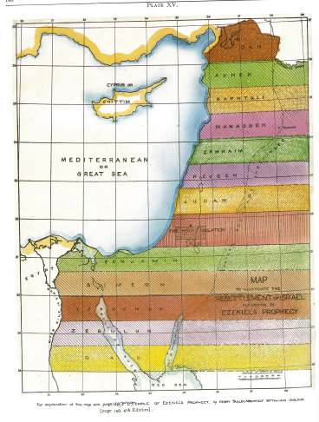

Slide 36
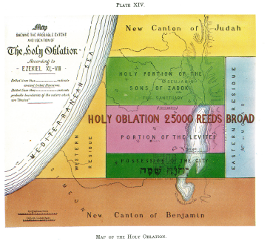
Kingdom will be the restored Ancient Kingdom of Israel

Slide 37
Jerusalem will be the Capital
Prophecy to Isaiah 24:23:
Then the moon shall be confounded, and the sun ashamed, when the LORD of hosts shall reign in mount Zion, and in Jerusalem, and before his ancients gloriously.
Psalm 102:19-21
For he (the LORD) hath looked down from the height of his sanctuary; from heaven did the LORD behold the earth;
To declare the name of the LORD in Zion, and his praise in Jerusalem;

Slide 38
Jerusalem will be the Capital
Prophecy to Jeremiah 3:17:
At that time they shall call Jerusalem the throne of the LORD; and all the nations shall be gathered unto it, to the name of the LORD, to Jerusalem: neither shall they walk any more after the imagination of their evil heart.

Slide 39
The Jews will be Gathered from among the Nations
Prophecy to Jeremiah 3:14:
Turn, O backsliding children, saith the LORD; for I am married unto you: and I will take you one of a city, and two of a family, and I will bring you to Zion:
Prophecy to Isaiah 11:12:
And he (the LORD) shall set up an ensign for the nations, and shall assemble the outcasts of Israel, and gather together the dispersed of Judah from the four corners of the earth.

Slide 40
Jesus will be the Supreme Ruler
2 Timothy 4:1:
I charge thee therefore before God, and the Lord Jesus Christ, who shall judge the quick and the dead at his appearing and his kingdom
Prophecy of Revelation 1:5:
And from Jesus Christ, who is the faithful witness, and the first begotten of the dead, and the prince of the kings of the earth.

Slide 41
The Saints will inherit the kingdom
Daniel 2
2 Timothy 1:9-10:
Who hath saved us, and called us with an holy calling, not according to our works, but according to his own purpose and grace, which was given us in Christ Jesus before the world began, But is now made manifest by the appearing of our Saviour Jesus Christ, who hath abolished death, and hath brought life and immortality to light through the gospel:

Slide 42
The Saints will inherit the kingdom
The Saints will inherit the kingdom
Prophecy of Daniel 7:27:
And the kingdom and dominion, and the greatness of the kingdom under the whole heaven, shall be given to the people of the saints of the most High, whose kingdom is an everlasting kingdom, and all dominions shall serve and obey him.
Prophecy of Daniel 12:2:
And many of them that sleep in the dust of the earth shall awake, some to everlasting life, and some to shame and everlasting contempt.

Slide 43
The Saints will inherit the kingdom
The Saints will inherit the kingdom
Revelation 3:21
  To him that overcometh will I grant to sit with me in my throne, even as I also overcame, and am set down with my Father in his throne.
The nature of the Saints is a very interesting subject
  Diversity of character
  Variance in rank and responsibility
  Roles as kings and priests who teach and judge

Slide 44
Summary
The Saints will inherit the kingdom
The kingdoms of men (the political organizations of the world) will be removed by Yahweh
The kingdom of heaven (aka the kingdom of God) will be set up on earth and will include the entire globe
This kingdom’s headquarters will be in Jerusalem and in the mountain of Zion and will be a restored kingdom of Israel
Jesus will be the King
There will be chosen saints to be kings and priests
This kingdom will remain for a millennium (1000 years)
A falling away will occur at the end
Any that oppose Jesus will be destroyed

Slide 45
Summary - Answers
Daniel 2:44
  And in the days of these kings shall the God of heaven set up a kingdom, which shall never be destroyed: and the kingdom shall not be left to other people, but it shall break in pieces and consume all these kingdoms, and it shall stand for ever.
What is “it”?
How long is “for ever”?
Who or what are “all these kingdoms”?
Kingdom of heaven on Earth
A mellinium (1000 years)
Any and all organized political nations – any who protest Christ or are in opposition to Christ

Slide 46
Summary - Answers
  What will happen in the future to Planet Earth?
  The kingdom of God will be on Earth for 1000 years – there is no literal burning of the earth – there will be one nation and one true religion righteously governed by Jesus Christ and his saints
  What will happen to humanity?
There will be a cleansing of those that oppose Christ. There will be no room for hoarding of wealth and there will be plenty for all who live in the kingdom

Slide 47
Summary - Answers
Do we fit in with God’s purpose?
What is the meaning of life?
“all things were created by him, and for him” – Col 1:16

Slide 48
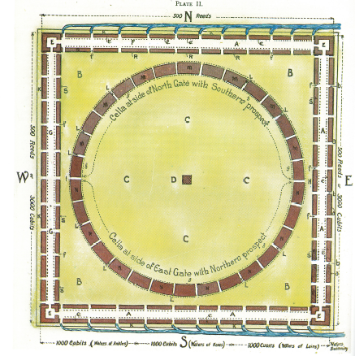
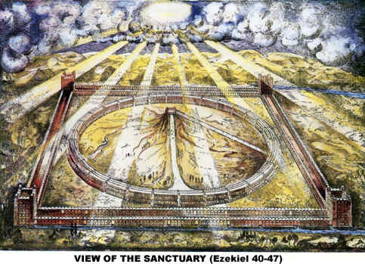
Summary - Answers
Mount Zion – Future Literal Temple

Slide 49
Summary - Answers
Jeremiah 16:19:
  O LORD, my strength, and my fortress, and my refuge in the day of affliction, the Gentiles shall come unto thee from the ends of the earth, and shall say, Surely our fathers have inherited lies, vanity, and things wherein there is no profit.
Zechariah 14:8-9:
And it shall be in that day, that living waters shall go out from Jerusalem; half of them toward the former sea, and half of them toward the hinder sea: in summer and in winter shall it be. And the LORD shall be king over all the earth: in that day shall there be one LORD, and his name one.

Slide 50
How do we be a part of God’s plan?
So how do we align ourselves to be a part this future Kingdom of heaven to be established here on Earth?
John 15:14-16:
  Ye are my friends, if ye do whatsoever I command you. Henceforth I call you not servants; for the servant knoweth not what his lord doeth: but I have called you friends; for all things that I have heard of my Father I have made known unto you. Ye have not chosen me, but I have chosen you, and ordained you, that ye should go and bring forth fruit, and that your fruit should remain

Slide 51
How do we be a part of God’s plan?
So how do we align ourselves to be a part this future Kingdom of heaven to be established here on Earth?
Matthew 4:4:
  It is written, Man shall not live by bread alone, but but every word that proceedeth out of the mouth of God.
If you are searching how to be a part of God’s plan then we need to understand his word and practice (obey) it so that we are his children – “he will be our God, and we shall be his people”

